Slide 1
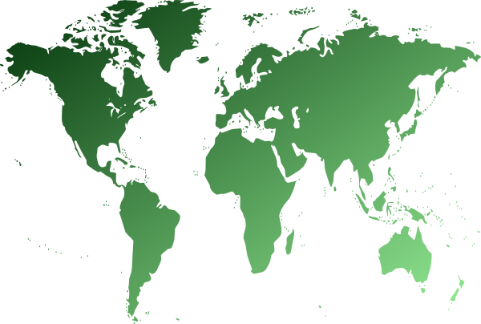
Branching Out: Reforestation
Have you ever celebrated Earth Day before? Do you know its history?

Slide 2
What is Earth Day?
Earth Day is celebrated on April 22nd and was first celebrated in 1970. Activist John McConnell was the first person to propose a day to “honor the Earth” and to bring awareness to the environmental movement.
Notes:
“Earth Day 1970 Part 1: Intro (CBS News with Walter Cronkite)”
Video length − 3:20

Slide 3
Deforestation
There are many issues contributing to Earth’s environmental crisis including plastics in the ocean, species decline, and what we’ll be exploring today, deforestation.
A forest is a large area of land primarily covered by trees. Deforestation is the clearing of forests by either humans or natural causes such as wildfires, droughts, and pests.
Some of the reasons for intentional deforestation are agricultural expansion, logging, mining, and urbanization.
Deforestation occurs all over the world but today, the greatest amount is occurring in tropical rainforests.
Notes:
National Geographic Education: https://education.nationalgeographic.org/resource/deforestation/
NASA Earth Observatory: https://earthobservatory.nasa.gov/features/Deforestation/deforestation_update3.php

Slide 4
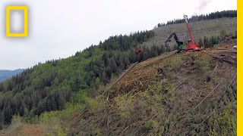
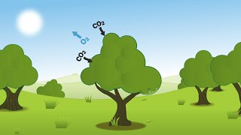
How does deforestation affect earth?
Notes:
National Geographic “Climate 101: Deforestation”
Video length − 2:48
The Woodland Trust “How trees capture and store carbon”
Video length − 2:29

Slide 5
Reforestation
Reforestation is the process of rebuilding forests by planting and growing trees in areas of land.
Traditionally, reforestation efforts have been done by hand. However, drones are now becoming a viable option to plant trees more efficiently and in areas that are inaccessible to humans.
Drones equipped with sensors are also able to monitor the growth and health of trees after they are planted.
Notes:
Earth Day Reforestation Fact Sheet: https://www.earthday.org/reforestation-fact-sheet/
The Woodland Trust “How trees capture and store carbon”
Video length − 2:29

Slide 6
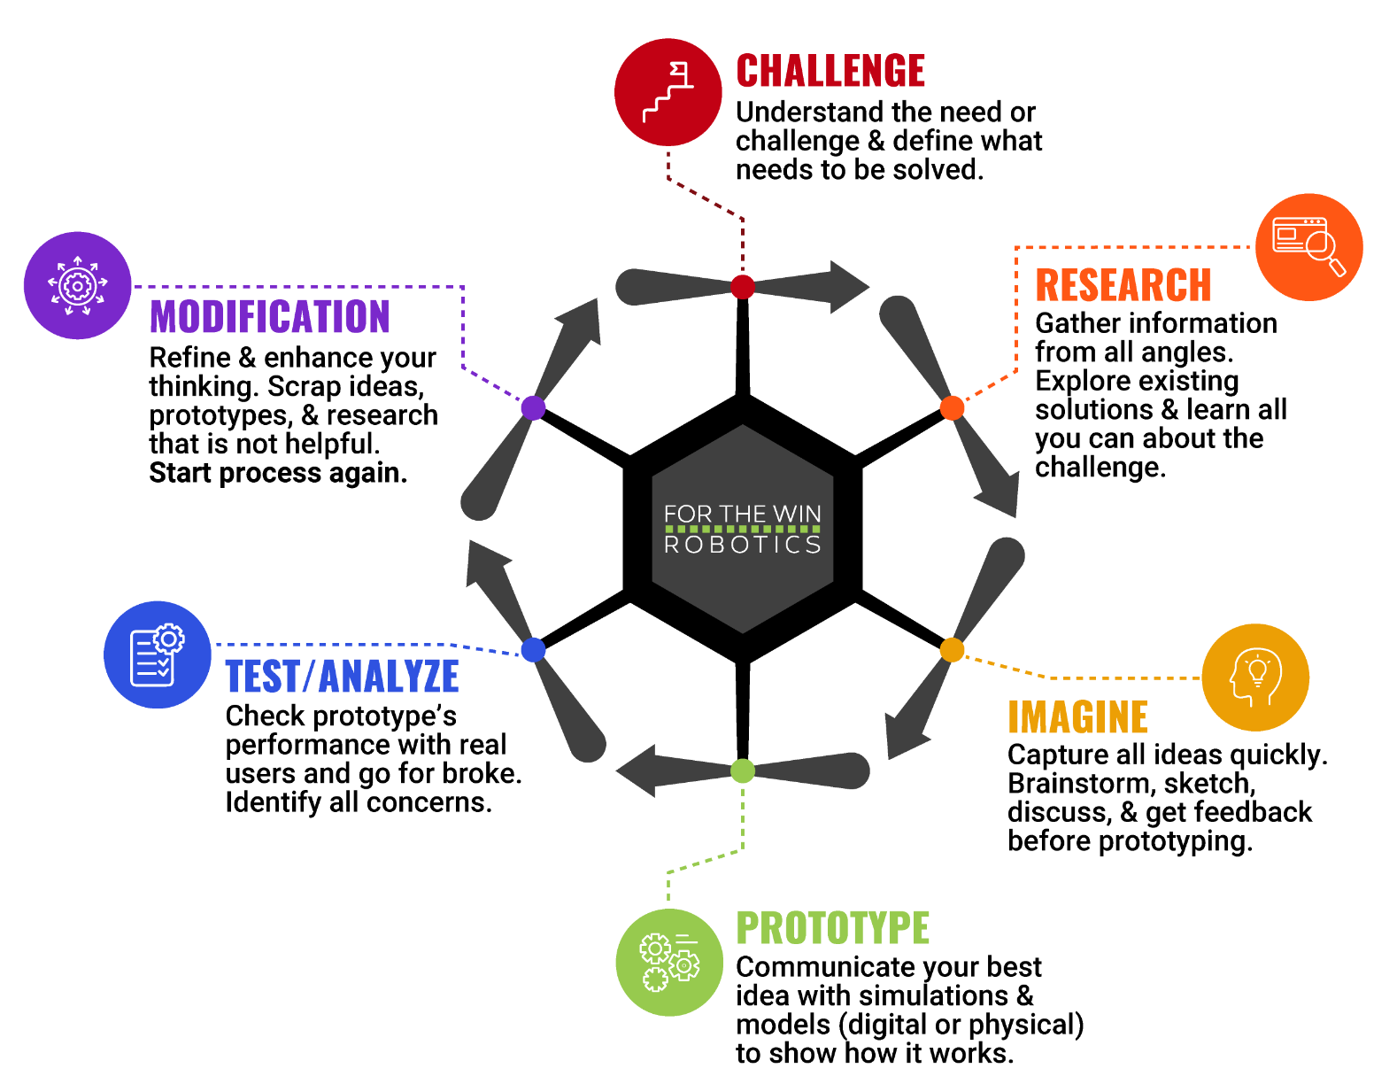
The Engineering Design Process
Let’s look at a variation of what is called the Engineering Design Process (EDP) which is a series of steps used by engineers to solve problems.
Notes:
Earth Day 1970 Part 1: Intro (CBS News with Walter Cronkite)
Video length − 3:20

Slide 7
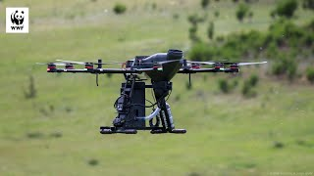
Case Study
Notes:
WWF Australia “Tree-Planting Drones”
Video length − 2:20
The Woodland Trust “How trees capture and store carbon”
Video length − 2:29

Slide 8
Activity Scenario
Hopper is planting melaleuca and eucalyptus shrubs in a 10′ × 10′ area of land affected by wildfires in Australia. These shrub species should be planted in alternating rows with the greatest numbers of seeds possible to ensure biodiversity. For optimal health and growth of these species, plant
the melaleuca seeds at least 2.5 feet away from other seeds,
and the eucalyptus seeds at least 5 feet away from other seeds.
You will code Hopper to fly and hover at each location where you wish to plant a seed. Hopper can only carry one seed species at a time so Hopper will need to land back on the landing pad to fill up on seed. For future reference when monitoring the growth of the shrubs, you will mark and list the coordinates where you planted each seed in Quadrant I of a Cartesian plane.
Notes:
The Woodland Trust “How trees capture and store carbon”
Video length − 2:29

