Slide 1
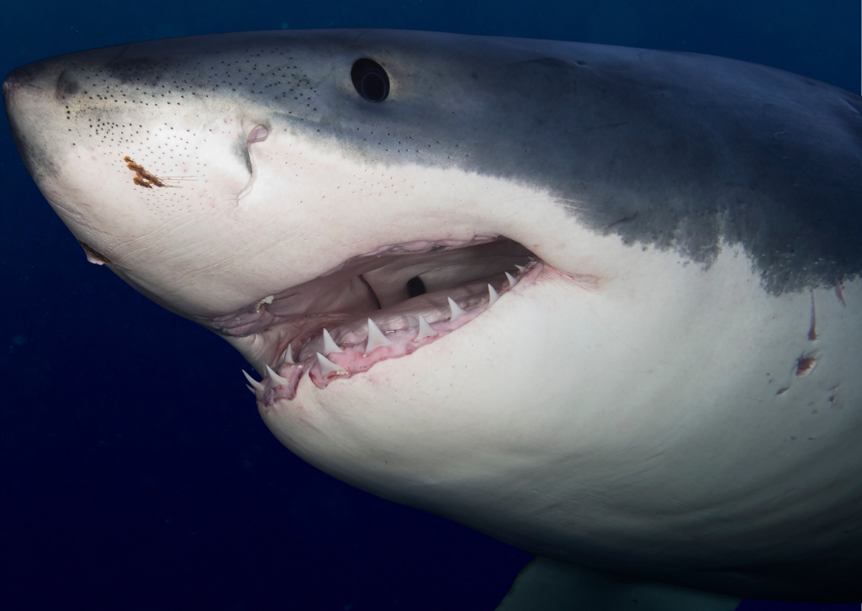


Sharks & Humans: Let’s cohabitate!
Have you ever watched any Shark Week television programming?

Slide 2
What is Shark Week?
Shark Week is an annual week in July when the Discovery Channel airs television programming all about sharks. The first Shark Week was in 1988 which had a focus on shark conservation and dispelling myths about sharks.
Over the years, these TV shows became more sensationalized and many scientists refuted claims made in some of their programming.
According to the non-profit Shark Stewards,
“It’s important to note that while Shark Week can play a positive role in raising awareness and generating interest in shark conservation, it can influence the attitudes and behavior of millions. The real and sustained conservation efforts will come from ongoing research, advocacy, and the commitment of individuals, organizations, and governments to protect sharks and the oceans they inhabit.”
Notes:
Shark Stewards: https://sharkstewards.org/shark-week-2023/

Slide 3

Sharks!
Notes:
Ocean School - École de l‘Océan “Sharks are awesome”
Video length − 3:56
https://www.youtube.com/watch?v=7jst8QbhzlM

Slide 4
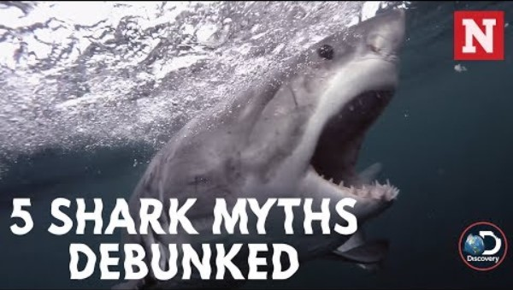
Shark Myths
Notes:
Newsweek “5 Shark Myths Debunked”
Video length − 2:15
https://www.youtube.com/watch?v=9qvHgMqyQzc

Slide 5
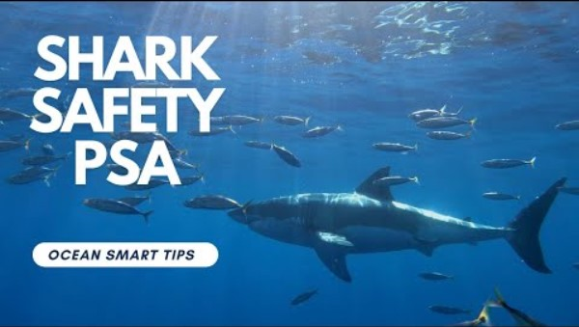
Cohabitating with Sharks
The Shark Lab is a research facility at the California State University, Long Beach. One of their missions is to educate the public on how to stay safe from sharks at the beach.
Notes:
CSULB Shark Lab: https://www.csulb.edu/shark-lab
CSULB Shark Lab “Shark Safety PSA”
Video length − 4:35
https://www.youtube.com/watch?v=sbbNLMozDSo

Slide 6
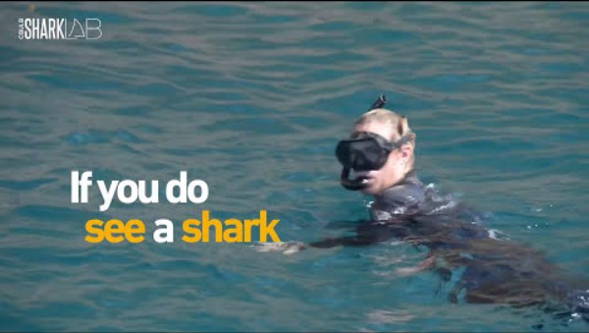
Staying Safe at the Beach
Notes:
CSULB Shark Lab “What to Do if You See a Shark: Beach Smart”
Video length − 2:34
https://www.youtube.com/watch?v=MyblrHgMGP0

Slide 7
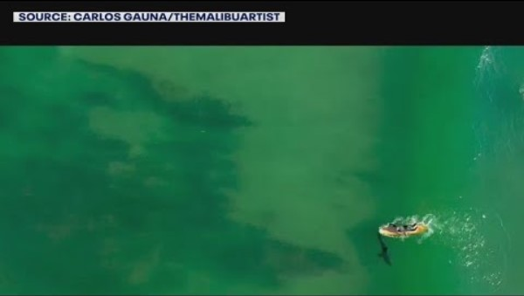
Monitoring Sharks with Drones
The Shark Lab at CSU Long Beach uses drones to monitor and collect data on sharks in Southern California.
Notes:
CSULB Shark Lab News: https://www.csulb.edu/news/article/dr-chris-lowe-adds-new-arsenal-his-study-of-sharks
FOX 11 Los Angeles “Drones helping researchers find sharks off shore”
Video length − 3:22
https://www.youtube.com/watch?v=2tJ3PXNkvQU

Slide 8
Group Discussion Questions on Drones
Drones (UAVs) with cameras are starting to be used to actively monitor shark activity to ensure beachgoer safety.
What could be some advantages of using drones to monitor sharks for beachgoer safety?
What could be some disadvantages of using drones to monitor sharks for beachgoer safety?
Notes:
Example discussion topics:
Better view of sharks underwater than other methods (for example from a boat), fast communication to swimmers if a shark is nearby, real-time monitoring, etc.
Initial startup cost, crashes, noise and motion could disturb wildlife, privacy and security concerns, limitations due to weather, limited battery life and flight time, etc.

Slide 9
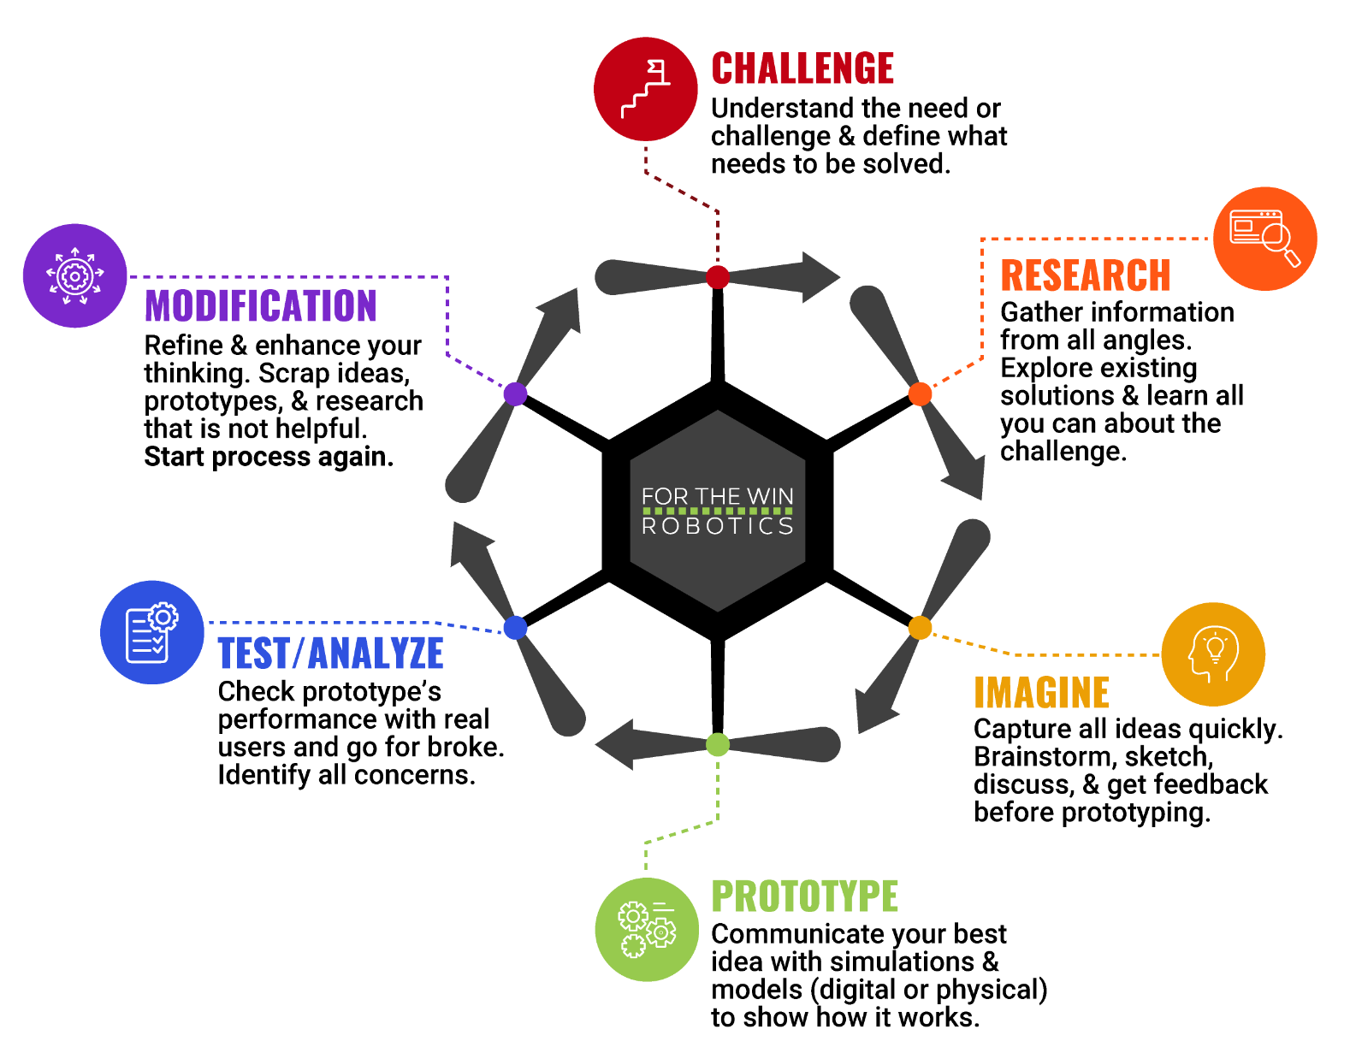
The Engineering Design Process
Let’s look at a variation of what is called the Engineering Design Process (EDP) which is a series of steps used by engineers to solve problems.

Slide 10
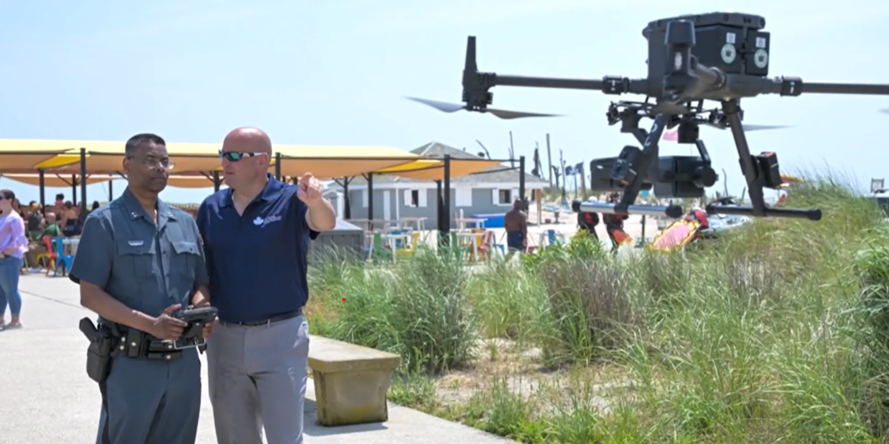
Case Study
Over the Fourth of July weekend in 2025, Long Island, NY used drones to patrol state park beaches to help lifeguards identify potential dangers to swimmers.
“In total, 28 drones will be deployed across state beaches, primarily focused on shark detection. The move comes after a woman was bitten last week at Jones Beach, likely by a juvenile sand tiger shark. In response, both state and county agencies have increased their use of aerial surveillance.”
Notes:
News 12 Long Island: https://longisland.news12.com/drones-to-patrol-state-park-beaches-for-sharks-and-swimmer-safety-july-4-weekend

Slide 11
Activity Scenario
You are working at a beach to assist lifeguards in detecting sharks that are getting too close to shore. You are doing this with the use of Hopper and its camera to ensure the safety of beachgoers.
You and a team will code Hopper to fly along the coastline of the beach with directions given from the lifeguards. Then, you will code Hopper to fly in the opposite direction so that Hopper can fly back and forth along the coastline.

